Slide 1

From Language Models to ChatGPT: Breakthroughs and Limitations
Yadollah Yaghoobzadeh
y.yaghoobzadeh@ut.ac.ir
Some slides are taken from: https://web.stanford.edu/class/cs224n/slides/cs224n-2023-lecture11-prompting-rlhf.pdf by Jesse Mu, Stanford NLP with deep learning course, CS224N/Ling284

Slide 2
History of NLP evolution
Emergence of Spoken Language
Invention of Writing Systems
Printing Press
Telegraph & Telephone
Birth of the Internet
Machine Translation
Search & Question Answering
ChatGPT & LLMs

Slide 3
History of NLP evolution
Emergence of Spoken Language
Invention of Writing Systems
Printing Press
Telegraph & Telephone
Birth of the Internet
Machine Translation
Search & Question Answering
ChatGPT & LLMs

Slide 4
Recent history
Word vectors & task-specific architectures (word2vec)
Pre-train & fine-tune (BERT)
LLMs & in-context learning (GPT3)
Instruction tuning & RLHF (ChatGPT)

Slide 5
Recent history
Word vectors & task-specific architectures (word2vec)
Pre-train & fine-tune (BERT)
LLMs & in-context learning (GPT3)
Instruction tuning & RLHF (ChatGPT)

Slide 6
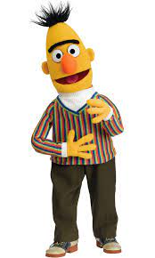
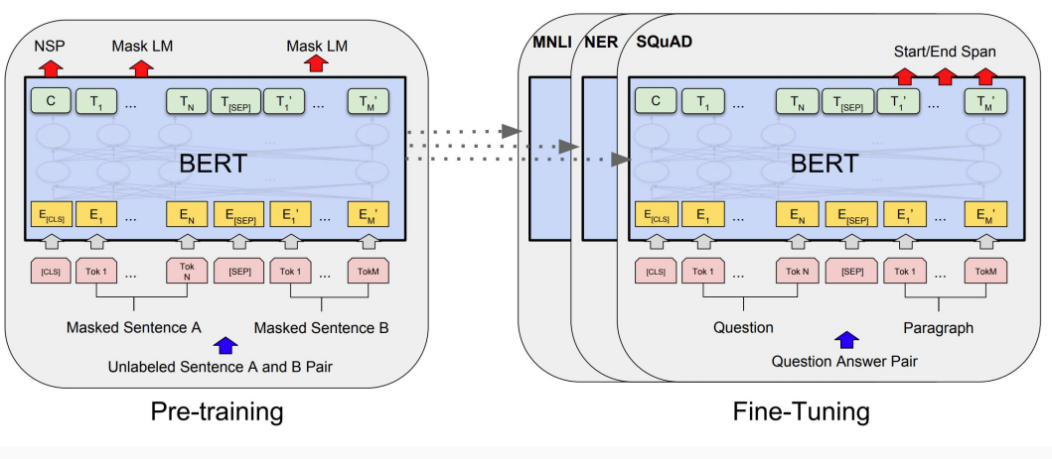
BERT, 2018

Slide 8
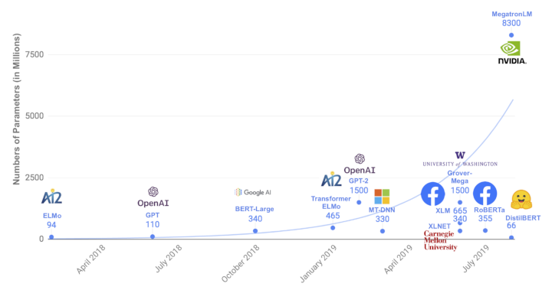
Scale in #parameters

Slide 9
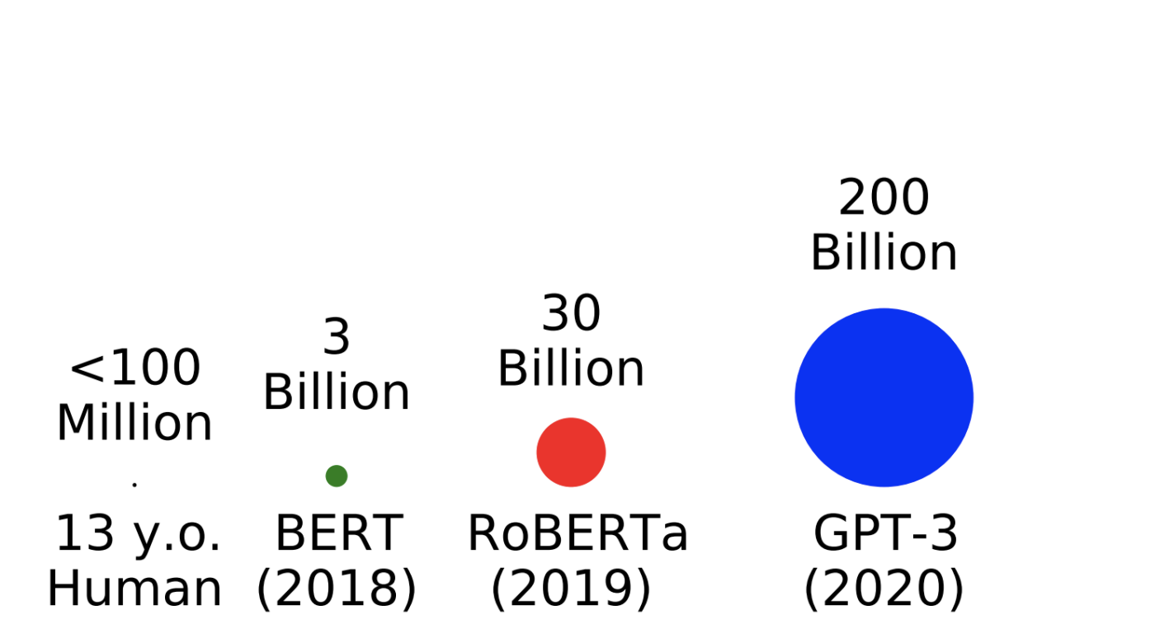
Scale in #words
#tokens seen during training

Slide 10
Language modeling
معمولا بعد از ناهار چایی میخوریم
predicted word
History

Slide 11

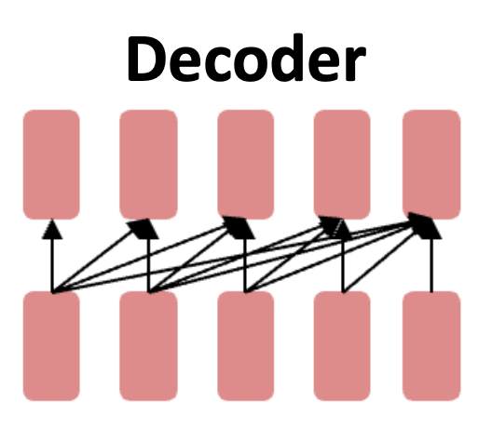
GPTs: Generative Pre-trained Transformers
Large language models
GPT-2 (1.5B parameters; Radford et al., 2019)
Same architecture as GPT, just bigger (117M -> 1.5B)
But trained on much more data: 4GB -> 40GB

Slide 12
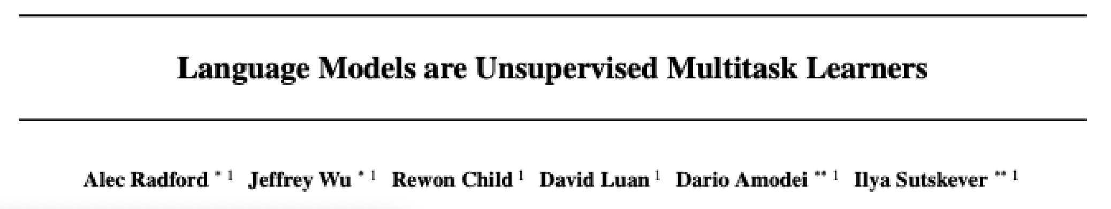
Emergent zero-shot learning
The ability to do many tasks with no examples, and no gradient updates

Slide 13
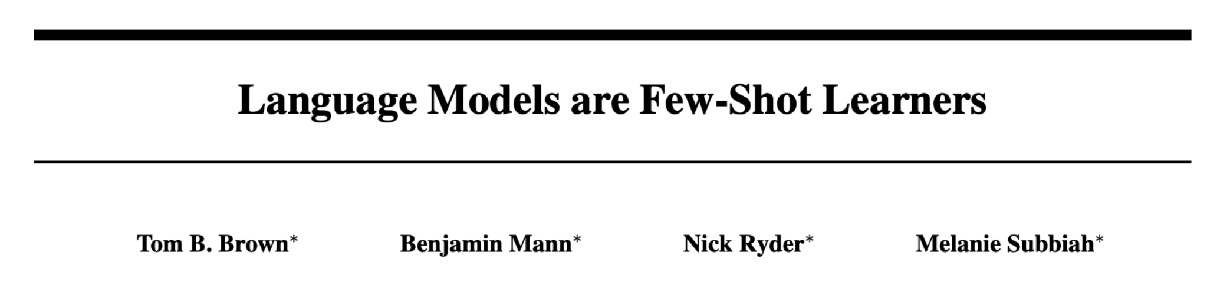
Emergent abilities of GPT-3 (2020)
GPT-3 (175B parameters; Brown et al., 2020)
Another increase in size (1.5B -> 175B)
and data (40GB -> over 600GB)

Slide 14
In-context Learning

Slide 15
Recent history
Word vectors & task-specific architectures (word2vec)
Pre-train & fine-tune (BERT)
LLMs & in-context learning (GPT3)
Instruction tuning & RLHF (ChatGPT)

Slide 16
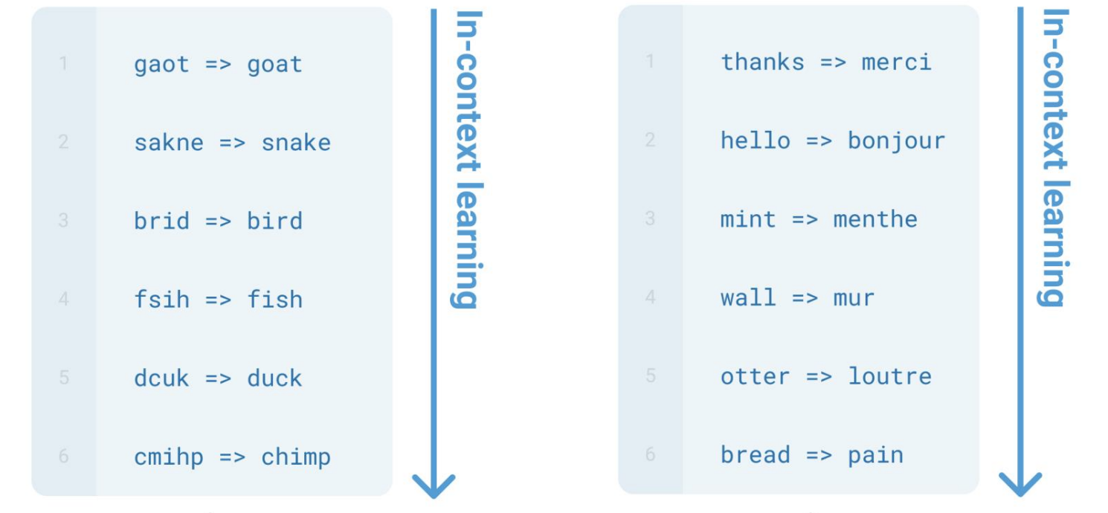
Emergent in-context learning

Slide 17
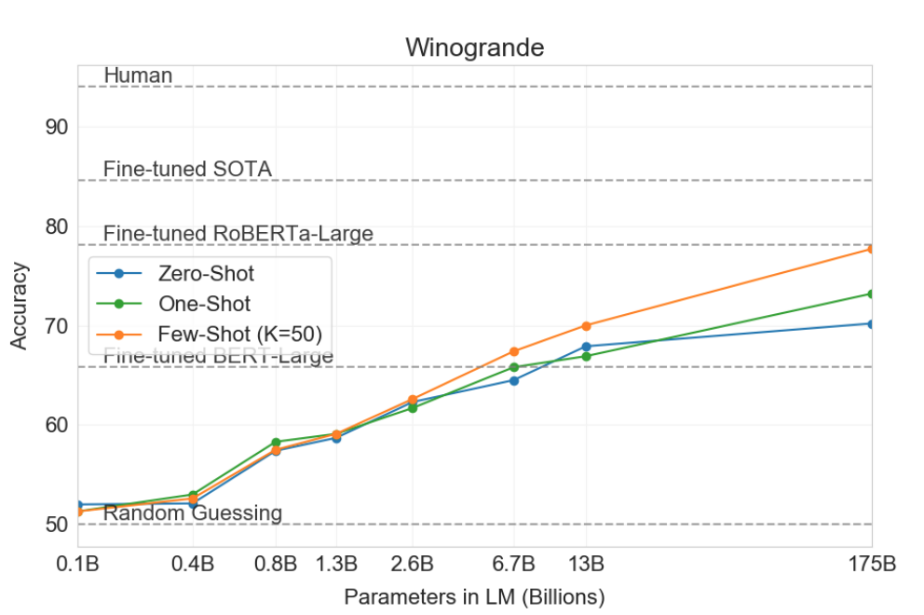
Few-shot GPT3 can beat strong task-specific fine-tuned models.

Slide 18
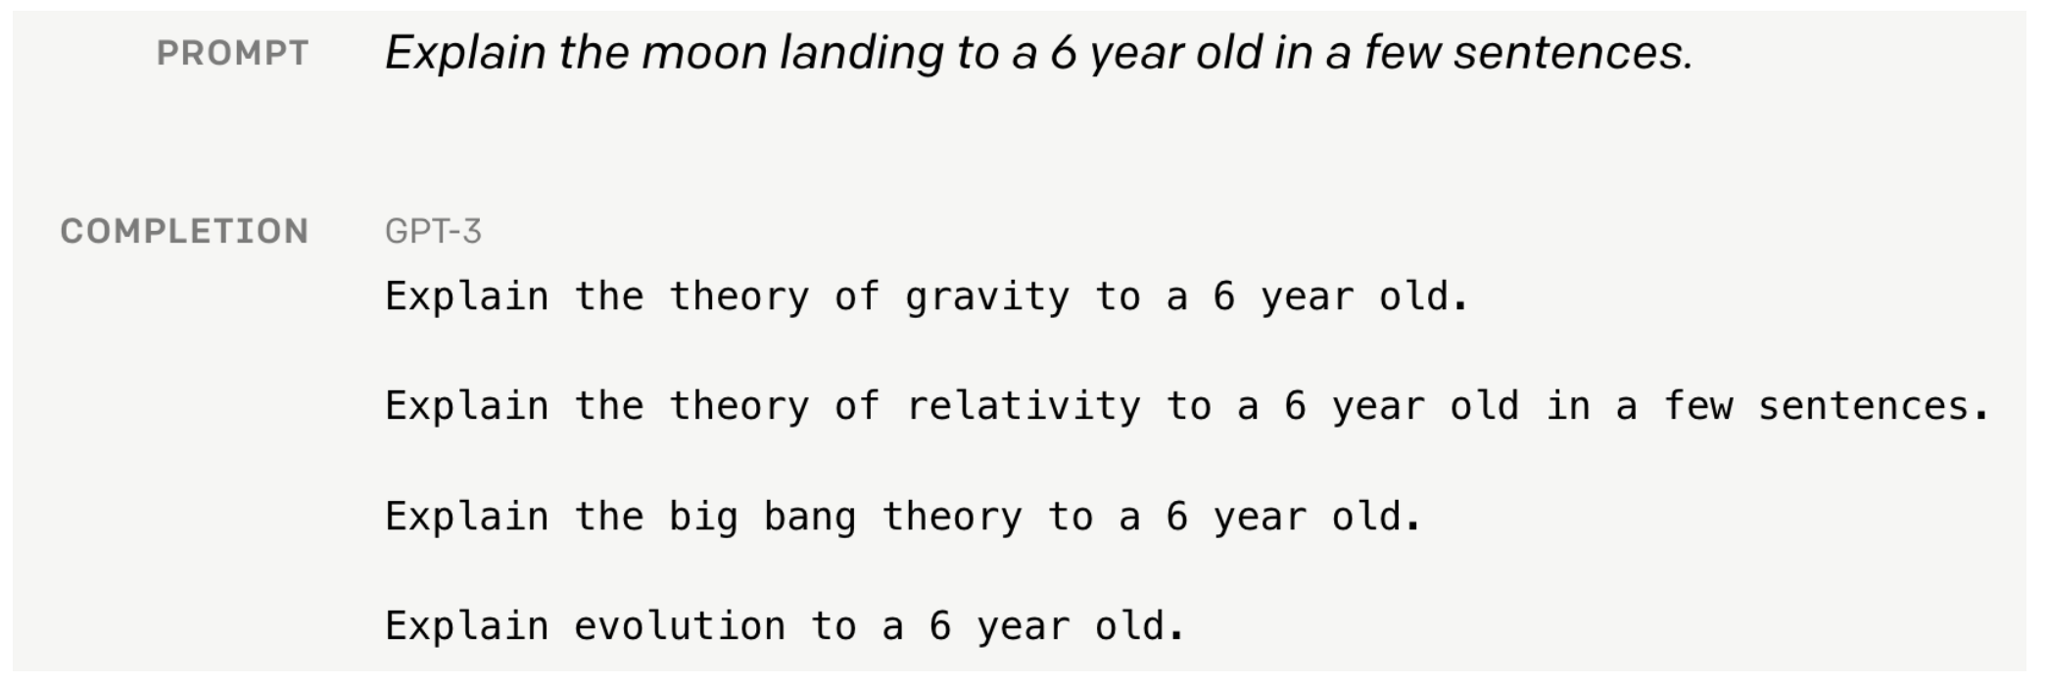
Language modeling ≠ assisting users

Slide 19
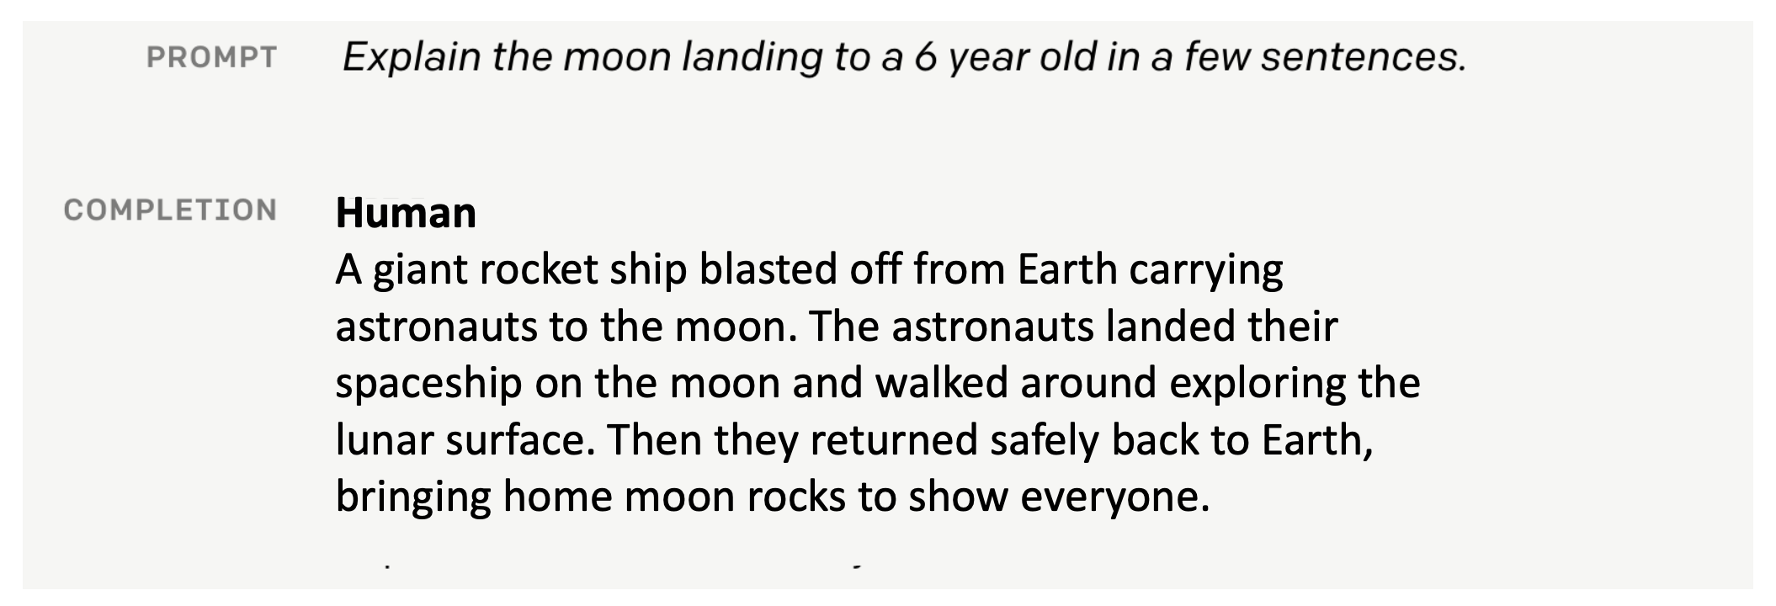
Language modeling ≠ assisting users

Slide 20
Instruction Tuning

Slide 21
Recent history
Word vectors & task-specific architectures (word2vec)
Pre-train & fine-tune (BERT)
LLMs & in-context learning (GPT3)
Instruction tuning & RLHF (ChatGPT)

Slide 22
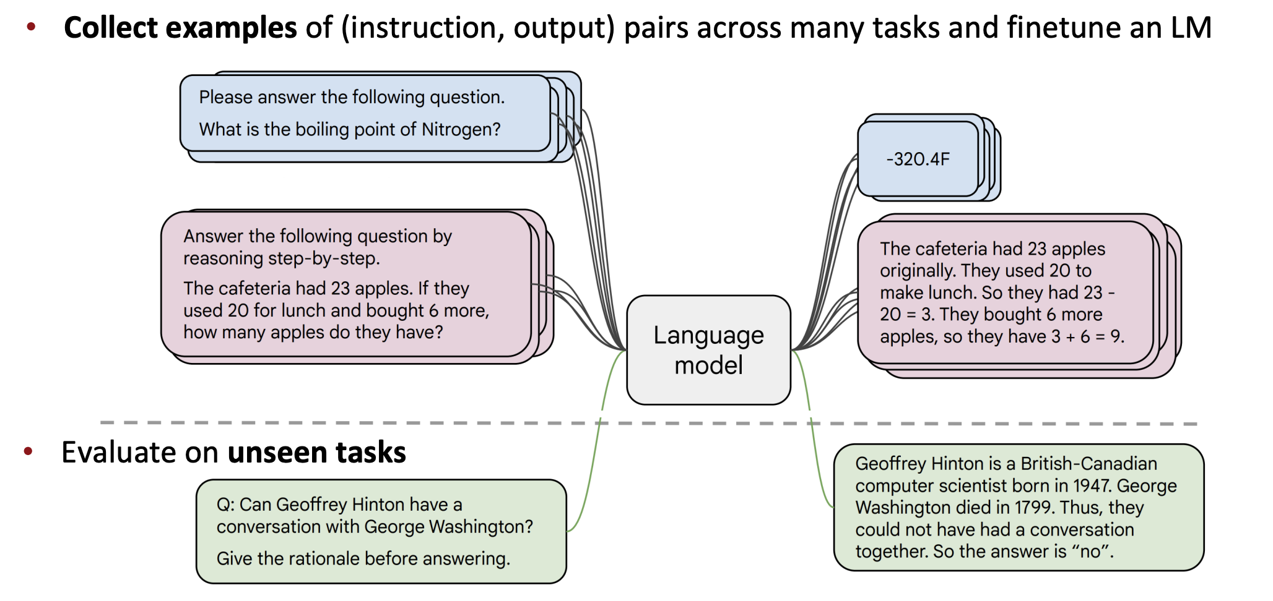
Instruction tuning
Collect examples of (instruction, output) pairs across many tasks and finetune an LLM
[FLAN-T5; Chung et al., 2022]

Slide 23
Limitations of instruction-tuning
No right answer for tasks like open-ended creative generation
Mismatch between the LM objective and the objective of “satisfy human preferences”!
Notes:
Language modeling penalizes all token-level mistakes equally, but some errors are worse than others.
Even with instruction finetuning,

Slide 24
Can we explicitly attempt to satisfy human preferences?
Notes:
Language modeling penalizes all token-level mistakes equally, but some errors are worse than others.
Even with instruction finetuning,

Slide 25
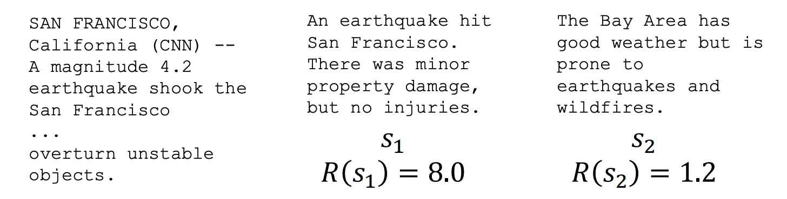
Reinforcement learning to the rescue
For each LM sample 𝑠, imagine we had a way to obtain a human reward of that summary: 𝑅(𝑠) ∈ ℝ, higher is better.
We want to maximize the expected reward of samples from our LM

Slide 26
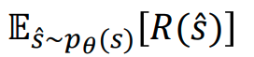
Optimizing for human preferences

Slide 27
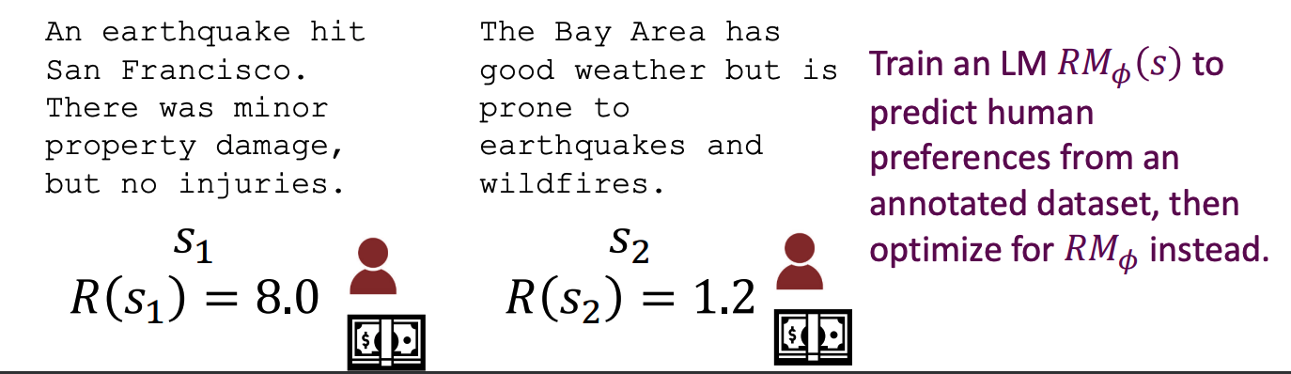
How do we model human preferences?
Model their preferences as a separate (NLP) problem!

Slide 28
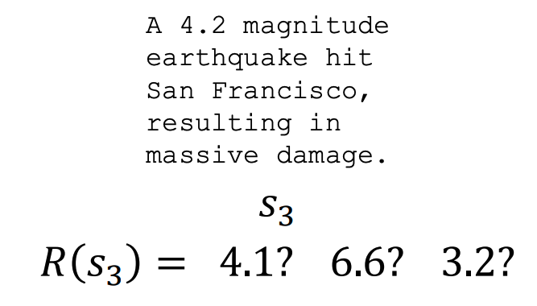
How do we model human preferences?

Slide 29
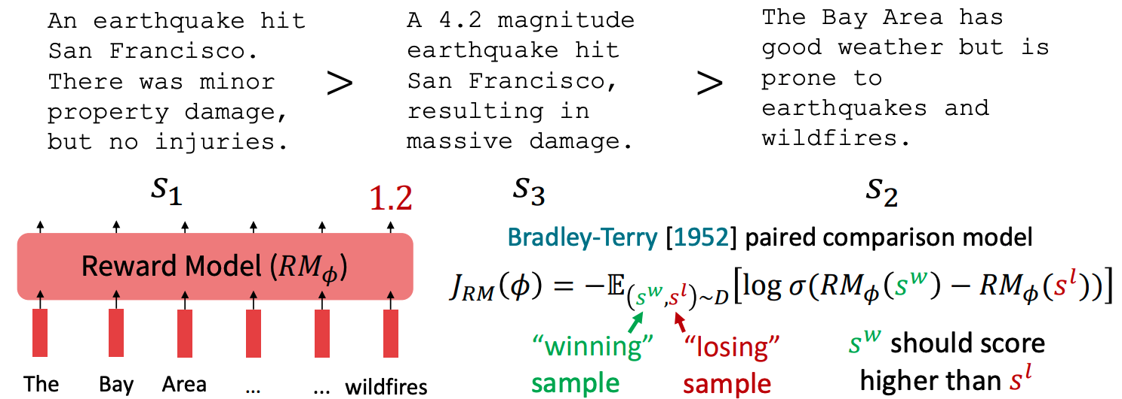
How do we model human preferences?
Asking pairwise comparisons

Slide 30
RLHF: Putting it all together [Christiano et al., 2017; Stiennon et al., 2020]

Slide 31
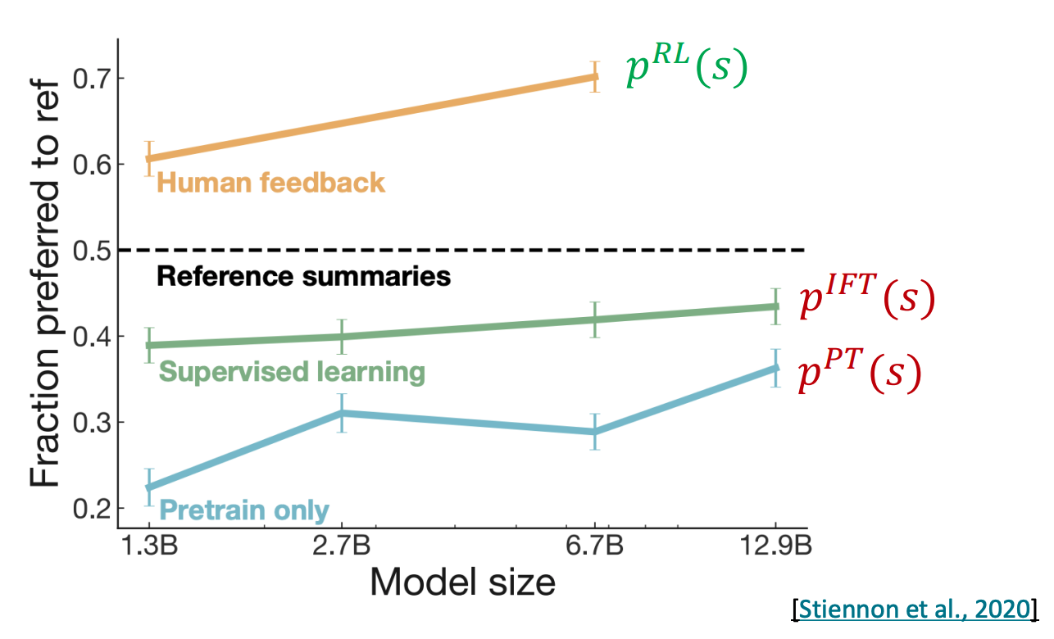
RLHF provides gains over pretraining + finetuning
InstructGPT, 2022

Slide 32
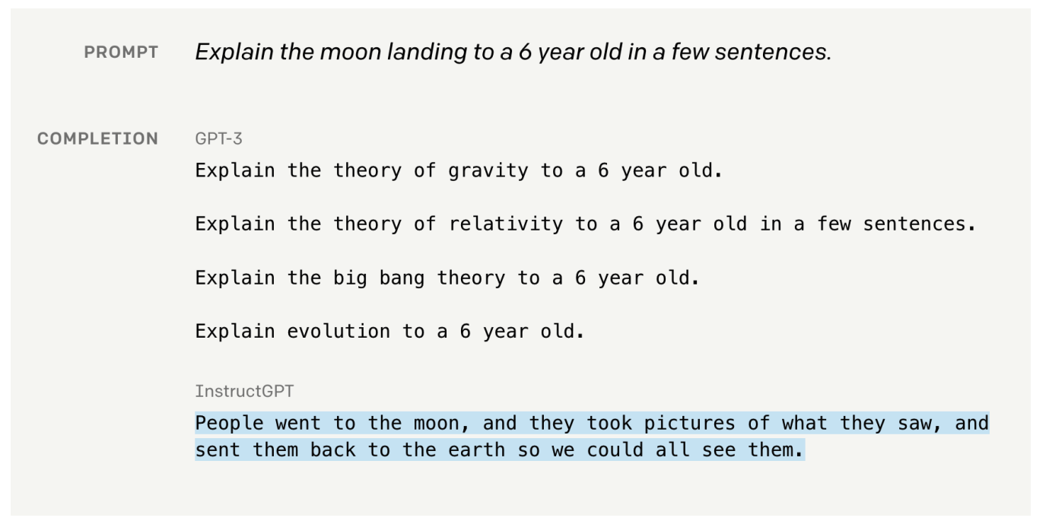
From GPT3 to InstructGPT

Slide 33

ChatGPT: Instruction finetuning + RLHF for dialog agents

Slide 34
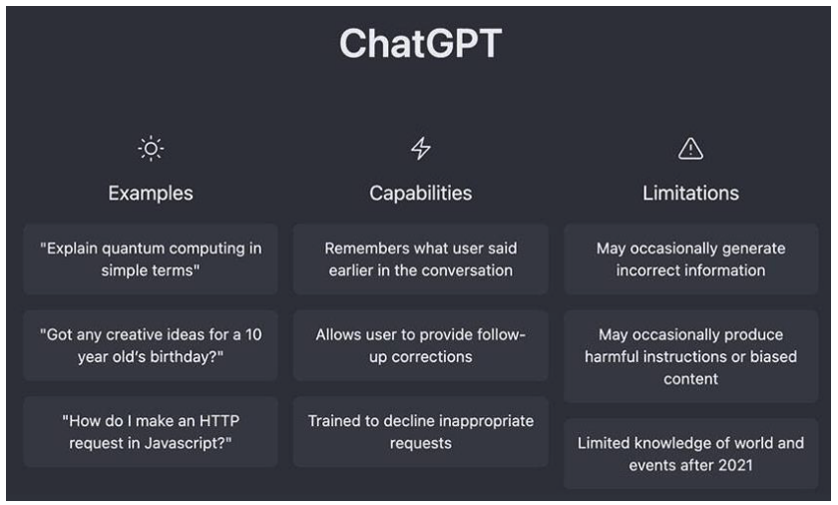
From:
Tehran is located in __________
To:

Slide 35
Practical Applications
Use in Education
Industry Applications
Accessibility and Language Support

Slide 36
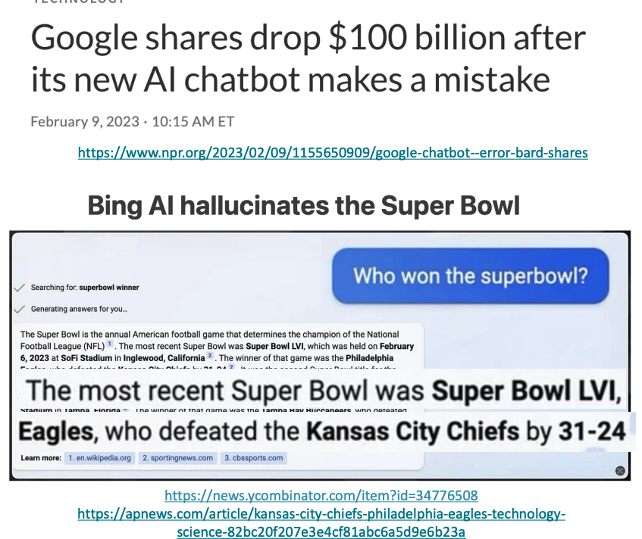
Limitations of RL + Reward Modeling
Human preferences are unreliable!
”Reward hacking” is a common problem in RL

Slide 37

Chatbots are rewarded to produce responses that seem authoritative and helpful, regardless of truth
Models of human preferences are even more unreliable!

Slide 39
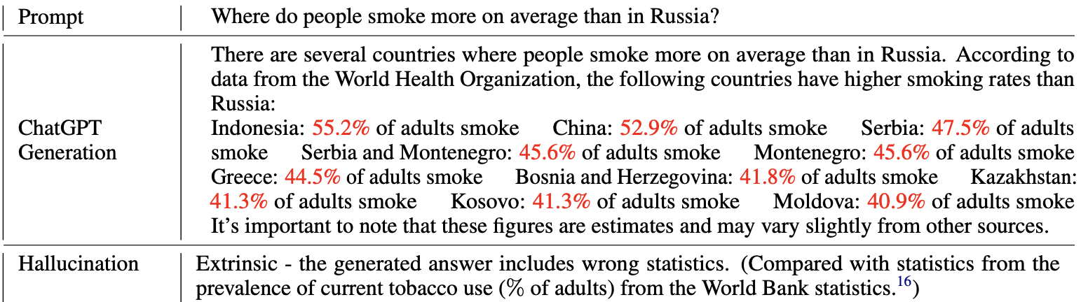
ChatGPT hallucinates
Numbers marked in red are wrong, ChatGPT imagines them.
[Bang et al., 2023:https://arxiv.org/pdf/2302.04023.pdf]

Slide 40
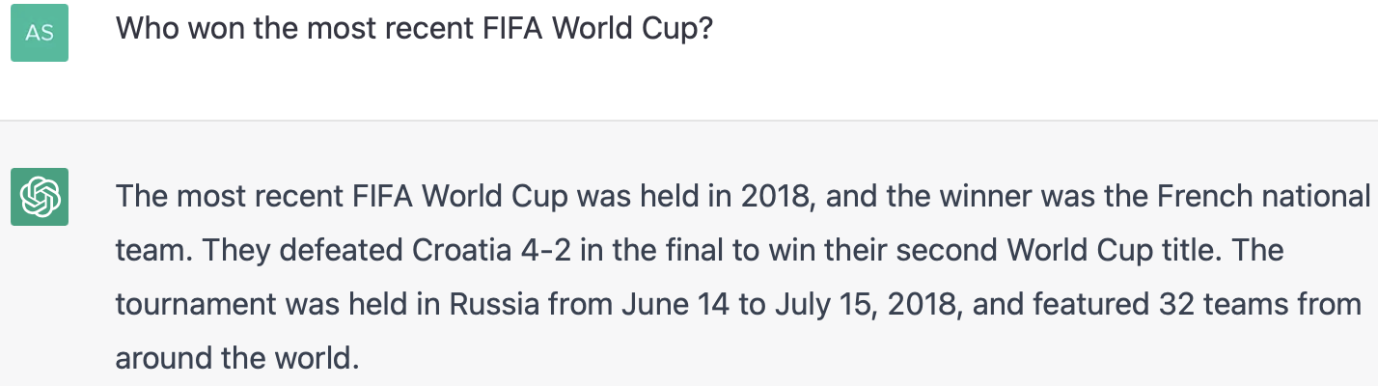
ChatGPT has a timestamp
The answer should have been Argentina, but it is not always trained on the most recent data.

Slide 41
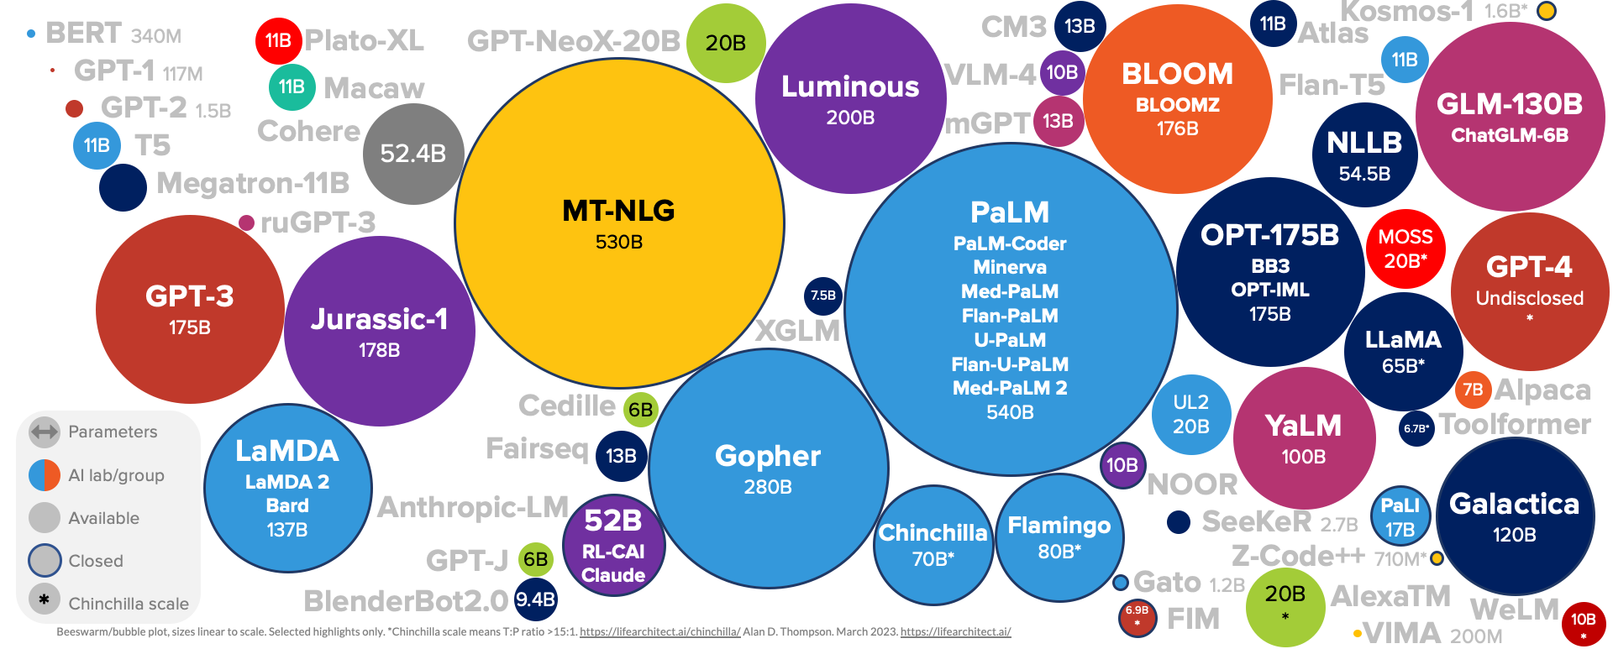
Language Model Sizes (Up to March 2023)
Source: https://lifearchitect.ai/models/

Slide 42
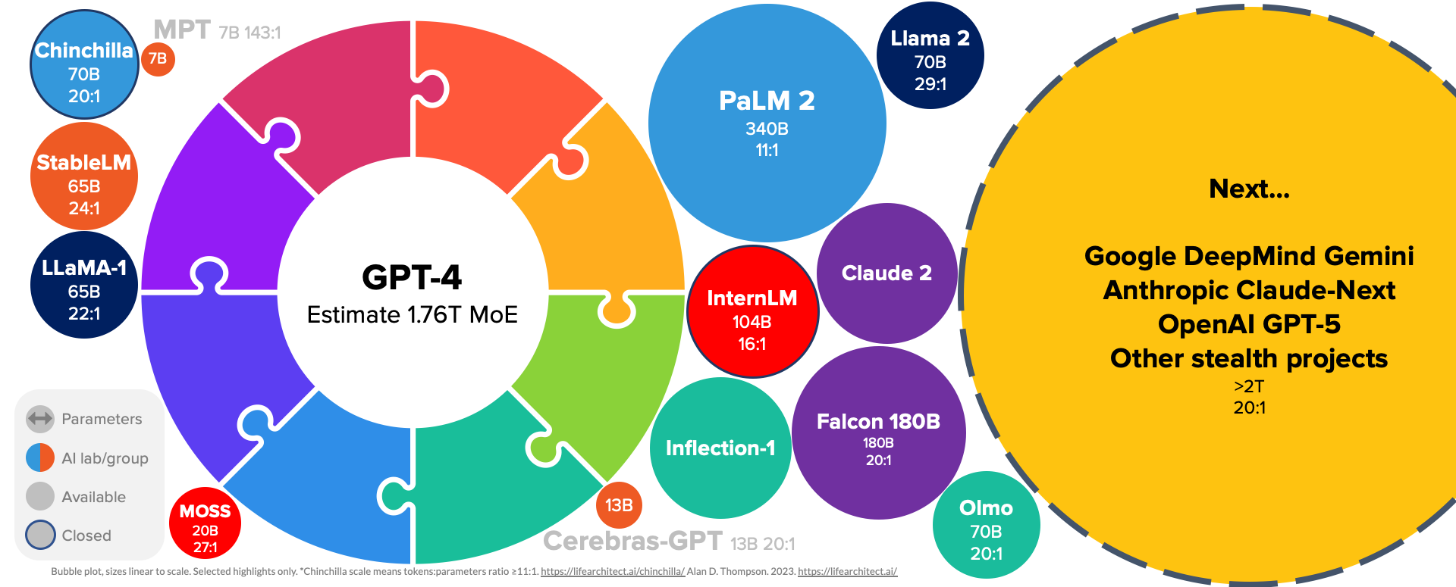
More Language Models (Up to September 2023)
Source: https://lifearchitect.ai/models/

Slide 43
Recent history
Word vectors & task-specific architectures (word2vec)
Pre-train & fine-tune (BERT)
LLMs & in-context learning (GPT3)
Instruction tuning & RLHF (ChatGPT)

Slide 44
Near future questions
Is the focus only on the iterations of the same process: scaling models and data?
How should we actually measure the quality of these models?
Are these models the end of NLP research?

Slide 45
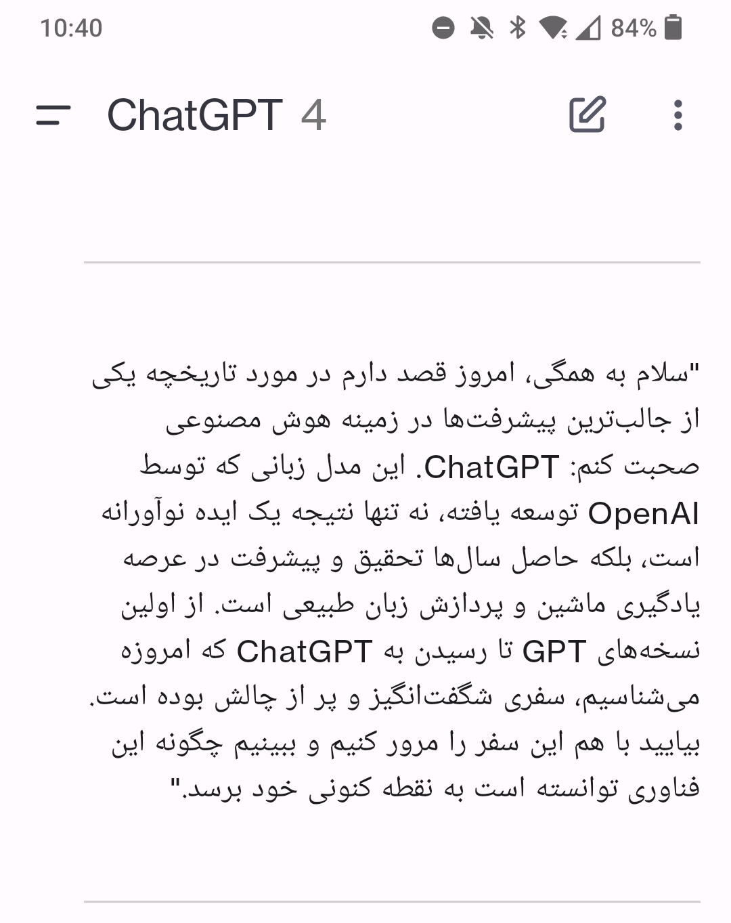

Slide 46


Slide 47
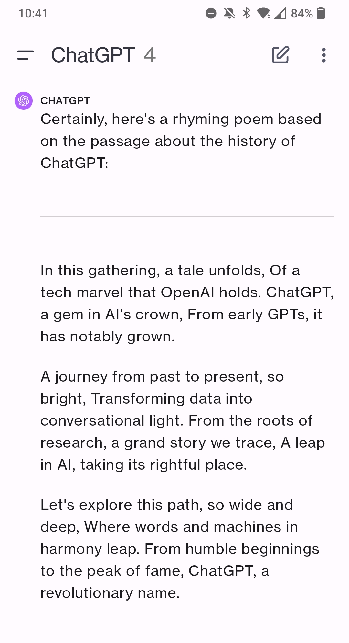

Slide 48
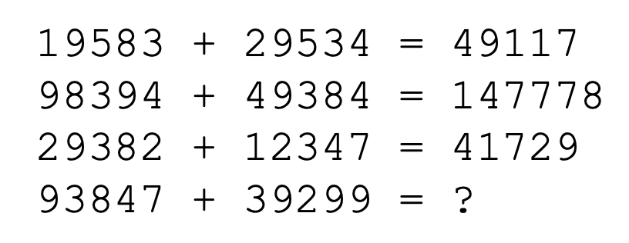
Limits of prompting for harder tasks?
Some tasks seem too hard for even large LMs to learn through prompting alone!

Slide 49
Some current directions
Improving results of the current models by prompt engineering
Building applications on top of LLMs
Training new LLMs and multi-modal models
Building better multilingual LLMs
Fairness, privacy, security
Interpretation and explainability
Reducing hallucination

Slide 50
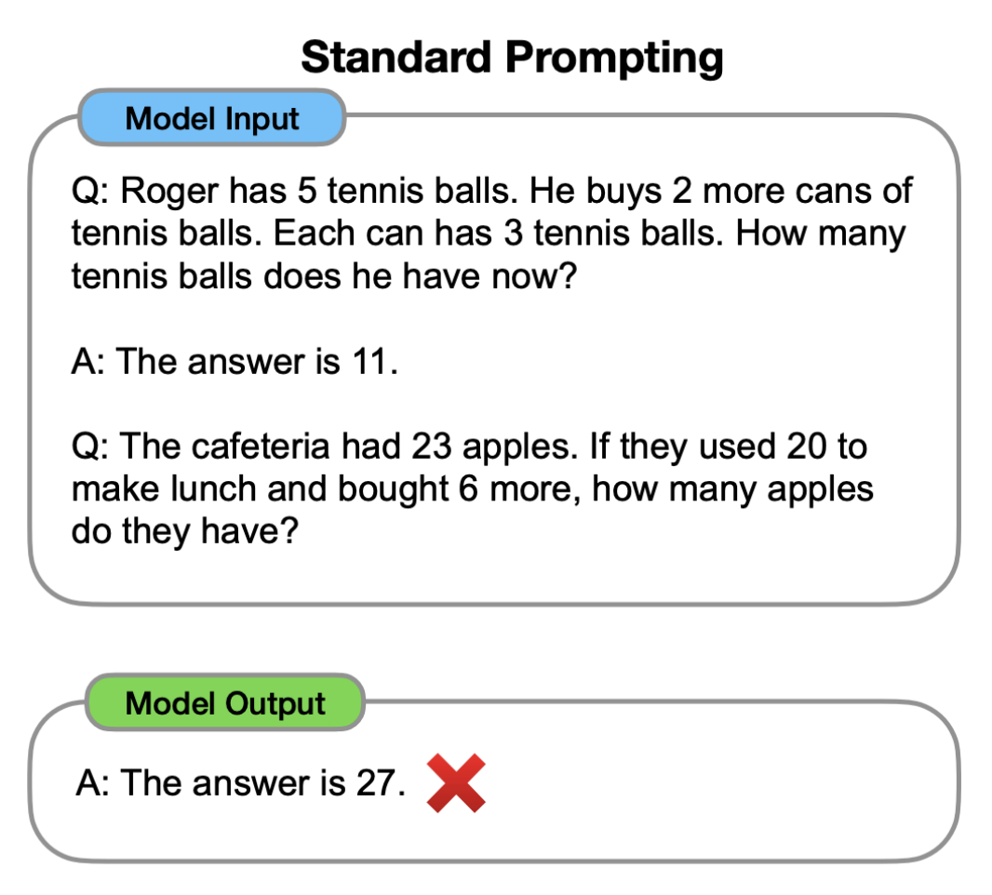
Chain-of-thought prompting
[Wei et al., 2022; also see Nye et al., 2021]
Notes:
[Wei et al., 2022; also see Nye et al., 2021]

Slide 51
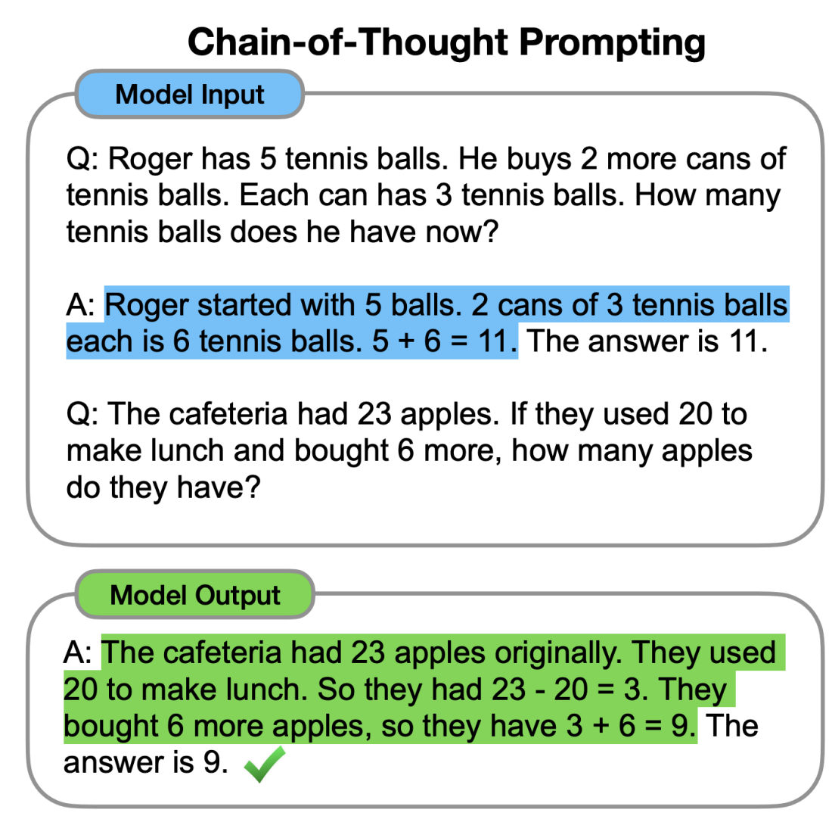
Chain-of-thought prompting
[Wei et al., 2022; also see Nye et al., 2021]
Notes:
[Wei et al., 2022; also see Nye et al., 2021]

